Slide 1
CAS 771 ProjecT – as a service provider And an eavesdropper
Tieyun Zhang
Shuiliang Wu
March 29th, 2023
Professor: Dr. Wenbo He
Notes:
Select

Slide 2
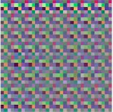
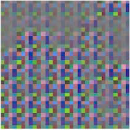
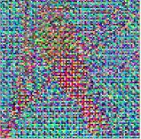
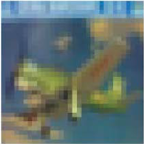
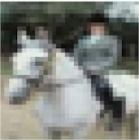
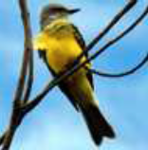
SCENARIO
Privacy-Preserving Machine Learning
Client
ML Service Provider
I_{e1,} I_{e2,} I_{e3, …} I_{eg}
Training & Testing
I_{1,} I_{2,} I_{3, …} I_{g}
+ Labels
Encryption Through Hill Cipher
Network Model
Feature
learning
Key K
Classification Results
Notes:
This project is basically mapping the real world case of privacy-preserving machine learning. The client, who has limited capacity to classify the collected images, out-sources the job to a third party ML service provider. To protect the image information, in this project client applied encryption through liner transformation which falls the category called Hill Cipher. The transformation key or cipher key is generated and kept at client side. So we as a service provider, our approach to provide the service should not decrypt the transformation key.
In the most cases, this encryption tends to be learnable, which means that it can encrypt images for human meanwhile third party service providers can directly train the model with the encrypted images and label info. Developing the network model is very important as it can avoid the privacy issue between client and third party in the business

Slide 3
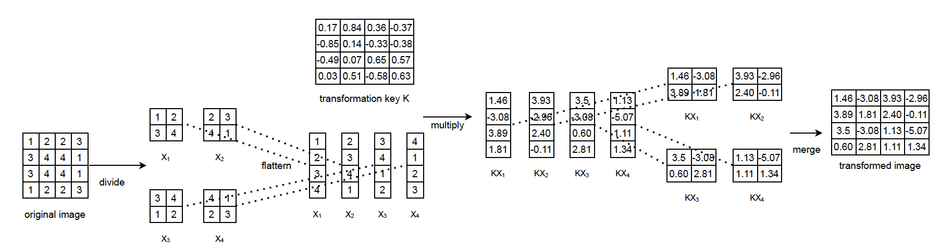
SCENARIO
Encryption Through Hill Cipher
Linear Transformation
Notes:
The encryption is a split-merge process on the image blocks and the linear transformation is performed on all the blocks through matrix multiplication. The output is the encrypted image of the same size.

Slide 4
SCENARIO
Two datasets, each contains training data, testing data (.npz) and their label info (.txt)
 | Dataset 1 (10000 images) | Dataset 2
Categories | 10 | 50
Image Resolution | (32, 32) | (224, 224)
Block Size | 4 | 8
Size of Transformation Key | 3 * (16, 16) | 3 * (64, 64)
Notes:
Dateset 1 has 1000 images and Dataset 2 is much bigger by looking at the size. They are different in terms of categories, image resolution, block size and size of transformation key. There differences are summarized in this table. However, each image in datasets shares the same transformation key.

Slide 5
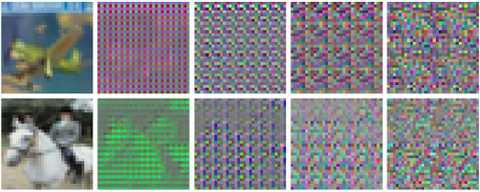
BASIC IDEAS
Step 1: As it is a block-based encryption, some learnable features were preserved after the encryption. We will try to train a few existing well-known CNN based image-classification models (e.g., ResNet) on the encrypted domain. The model with the best performance will be selected as the baseline for Step 2.
Step 2: We will add an adaptation network to recover more features from the encrypted images and then feed the adapted images to the baseline to build an Encryption-Robust CNN model (ER-CNN)
Notes:
For example in second column, we can still see the shape of the horse and even a little bit in the third column.
And expecting some accuracy on both datasets.

Slide 6
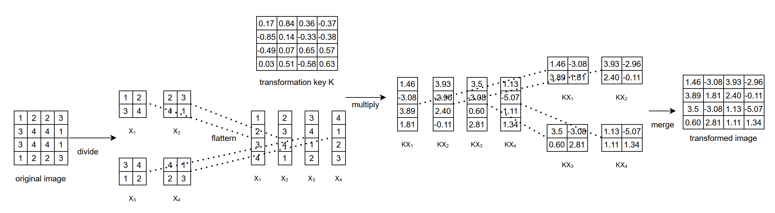
BASIC IDEAS
Use Convolution to Perform Hill Encryption and Decryption
`
1 | 2
3 | 4
2 | 3
4 | 1
0.17 | 0.84
0.36 | -0.37
1.46 | 3.93
3.36 | -0.37
-0.85 | 0.14
-0.36 | -0.37
-3.08 | 2.96
0.36 | -0.37
Encryption is essentially a convolution process
-0.49 | 0.07
0.36 | -0.37
3.89 | 2.40
0.36 | -0.37
3 | 4
1 | 2
4 | 1
2 | 3
*
1.81 | -0.11
2.81 | 1.34
0.03 | 0.51
-0.58 | 0.63
Notes:
Let’s dive into the foundation of this adaptation network. We take the encryption as the the example to demonstrate the feature recovering process as fundamentally they are the same. The hill cipher encryption is essentially a convolution process. As we can see, eg 1.46 from KX1, it is calculated through the multiplication of vector X1 and 1st row of transformation key K. It is equivalent to the convolution of these two matrixes.

Slide 7
BASIC IDEAS
Use Convolution to Perform Hill Encryption and Decryption
`
convolution kernels
feature maps
1 | 2
3 | 4
2 | 3
4 | 1
0.17 | 0.84
0.36 | -0.37
1.46 | 3.93
3.36 | -0.37
-0.85 | 0.14
-0.36 | -0.37
-3.08 | 2.96
0.36 | -0.37
-0.49 | 0.07
0.36 | -0.37
3.89 | 2.40
0.36 | -0.37
3 | 4
1 | 2
4 | 1
2 | 3
*
1.81 | -0.11
2.81 | 1.34
convolution
0.03 | 0.51
-0.58 | 0.63
Notes:
This top feature map can be obtained by convolution between input matrix and the blue matrix with the convolution stride of 2.
The rest three numbers of KX1 are obtained through the similar convolution between the first block and the rest orange, green and pink matrix. The rows of the transformation key are basically acting as convolution kernels and in this example, we have four kernels thus expecting four 2x2 feature maps. In our convolution process, KX1 is treated as a pixel of four features.

Slide 8
BASIC IDEAS
Use Convolution to Perform Hill Encryption and Decryption
`
1.46 | 3.93
3.36 | -0.37
1.46 | -3.08
3.89 | 1.81
3.93 | -2.96
2.40 | -0.11
-3.08 | 2.96
0.36 | -0.37
Resizing or
Deconvolution
3.89 | 2.40
0.36 | -0.37
adapted image
1.81 | -0.11
2.81 | 1.34
3.5 | -3.08
0.60 | 2.81
1.13 | -5.07
1.11 | 1.34
1. recover the spatial info;
2. adapt to ResNet’s input requirements
Notes:
Next step is to resize or deconvolute the feature maps into the adapted image which has the same resolution as input. It is 4x4 in this example. The purpose of this step is to recover the spatial info and adapt to ResNet’s input requirements.

Slide 9
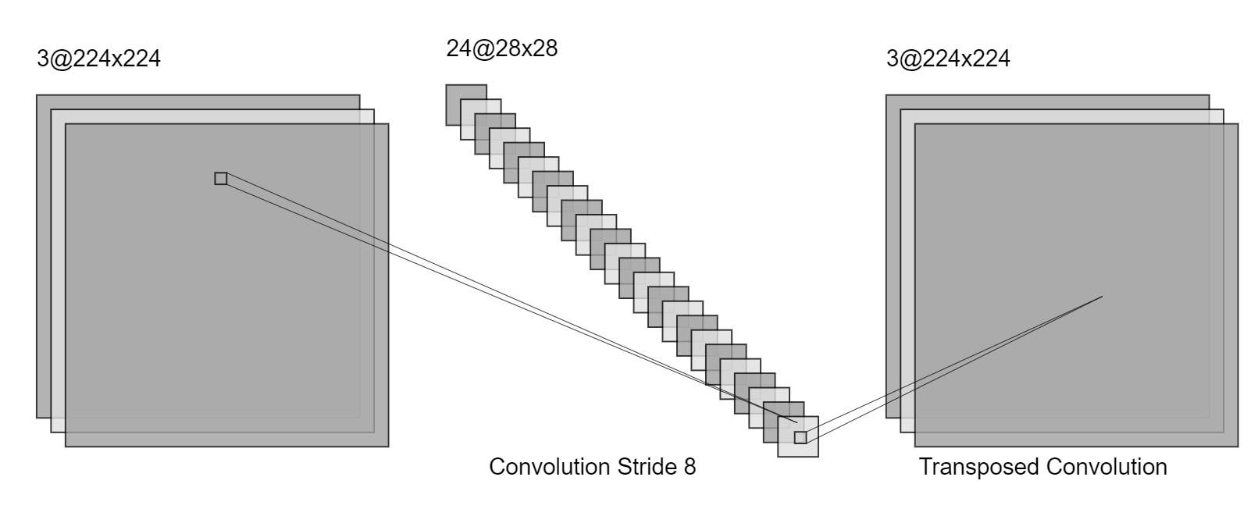
Proposal
Architecture of the Adaptation Network
convolution layers
deconvolution layers
192@28x28
Of the same resolution as the input;
contains richer learnable features.
Encrypted Images
Adapted Images
Notes:
This slide shows the architecture of the adaptation network. As we showed before, we put the convolution layers after input images and then is the deconvolution layers. After the adaptation, we are expecting the adapted images of the same resolution as the input. Meanwhile, the adapted images should contain richer learnable features compared to encrypted images.

Slide 10
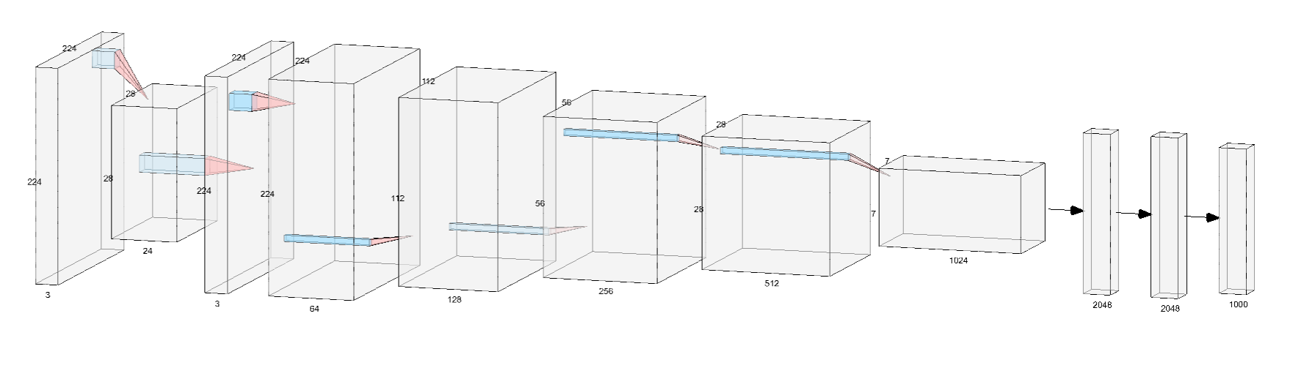
Proposal
Pipeline of Encryption-Robust CNN model: Add an Adaptation Network
adapted images
Adaptation Network
Feature Learning Network
Classification Network
Notes:
This is the pipeline of the encryption-robust CNN model after the addition of the adaptation network. The adapted images are fed to feature learning network and then classification network which is the baseline we select during step 1.

Slide 11
Models picked
Eight Models: ResNet34, ResNet50, DenseNet, ResNeXt-50, ConvNeXt (Tiny, Small, Base, Large)
ResNet50 (reached at 67.22% on dataset1 during mid-term)
Summary of selected CNN models
Architecture | Year Introduced | Pros | Cons
ResNet Family | 2015 by Microsoft | - Address the problem of vanishing gradients - Can enable deeper network architectures | - May have more parameters to learn than other architectures - May be sensitive to initialization - Can be computationally expensive
DenseNet | 2016 by Tsinghua University and Microsoft | - Efficient feature reuse - Can learn more complex representations | - High memory usage - Can be computationally expensive - May be sensitive to batch size
ResNeXt50 | 2016 by Facebook | - Can learn more diverse features | - May require more computational resources - Limited number of cardinalities
ConvNeXt Family | 2020 by Carnegie Mellon University | - Combines convolutional and fully connected layers - Adaptively combines different features from different layers to improve performance | - May require more computational resources
Notes:
From mid-term presentation:
Batch size = 128
RESNET 34
GAN
ConvNeXtxLARGE (86.7%) ConvNeXtBase (90+%)
Data enhancement & transformations
Change the kernel size (2% improvement)
Remove the pooling layers

Slide 12
Hyper-Parameter Tuning
Batch Size = 32
Batch Size, Learning Rate and Kernel Size
Notes:
Optimized through performance comparison on ResNet34 & 50, verified on ResNext50 and ConvNext
Batch Size = 32
1, performance
2, efficiency

Slide 13
Hyper-Parameter Tuning
Learning Rate= 0.002
Batch Size, Learning Rate and Kernel Size
Notes:
Optimized through performance comparison on ResNet50
Learning Rate= 0.002
1, performance

Slide 14
Hyper-Parameter Tuning
Dataset1: Kernel Size= 4
Dataset2: Kernel Size= 8
Batch Size, Learning Rate and Kernel Size
Notes:
Optimized through performance comparison on ResNet50
Kernel Size= 4
Kernel Size= 8
1, performance

Slide 15
Model comparison
Dataset1: Best Accuracy= 84.25%
Batch Size = 32, Learning Rate = 0.002, Kernel Size = 4 and Epoch = 20
Notes:
30min per run

Slide 16
Model comparison
Dataset2: Best Accuracy= 96.04%
Batch Size = 32, Learning Rate = 0.002, Kernel Size = 8 and Epoch = 20
torch.cuda.OutOfMemoryError: CUDA out of memory
Not Worth
Not Worth
Not Worth
Notes:
30min per run
Optimized through performance comparison on ResNet50
Kernel Size= 4
Kernel Size= 8
1, performance
torch.cuda.OutOfMemoryError: CUDA out of memory. Tried to allocate 20.00 MiB (GPU 0; 10.00 GiB total capacity; 9.08 GiB already allocated; 0 bytes free; 9.28 GiB reserved in total by PyTorch)

Slide 17
adaptation
Batch Size = 32, Learning Rate = 0.002, Kernel Size = 8 and Epoch = 20
Notes:
30min per run
Optimized through performance comparison on ResNet50
Kernel Size= 4
Kernel Size= 8
1, performance

Slide 18
DEcryption
Basic idea: The adaption network recovered/decrypted the encrypted image
ConvNeXt
Encrypted
Image
Adaptation
Network
Classification
result
96.04%😊
ConvNeXt
Encrypted
Image
Classification
result
94.28%

Slide 19
DEcryption
Basic idea: The adaption network recovered/decrypted the encrypted image
ConvNeXt
Encrypted
Image
Adaptation
Network
Classification
result
96.04%😊
Decrypted
Image?

Slide 20
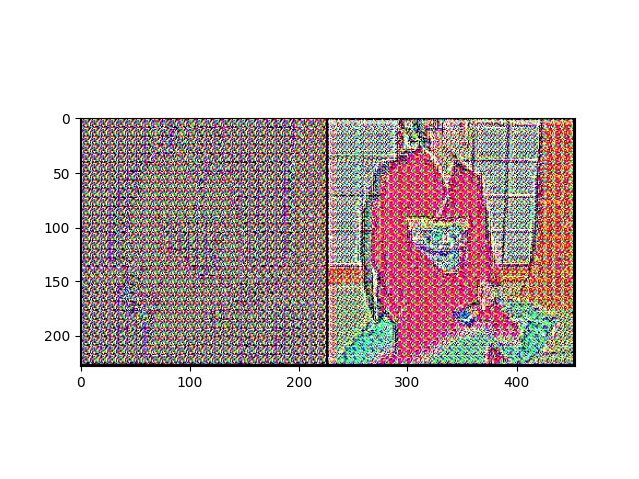
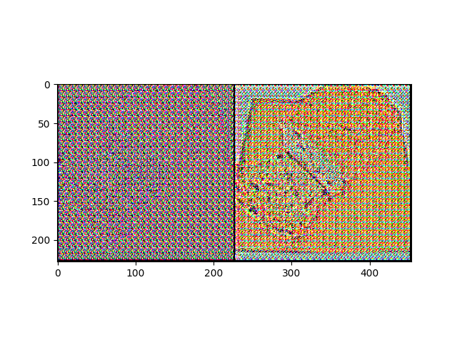
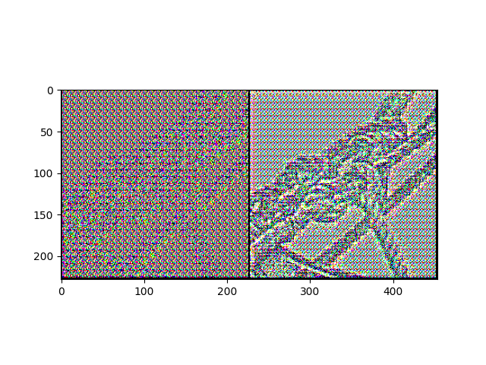
DEcryption
It’s INDEED the decrypted image
Visualize adapted image on dataset 2
Encrypted
Image
Adaptation
Network
Adapted
Image
Notes:
We decomposed the adaptation network from the model, and passed the encrypted image into the adaptation network, getting the adapted image.

Slide 21
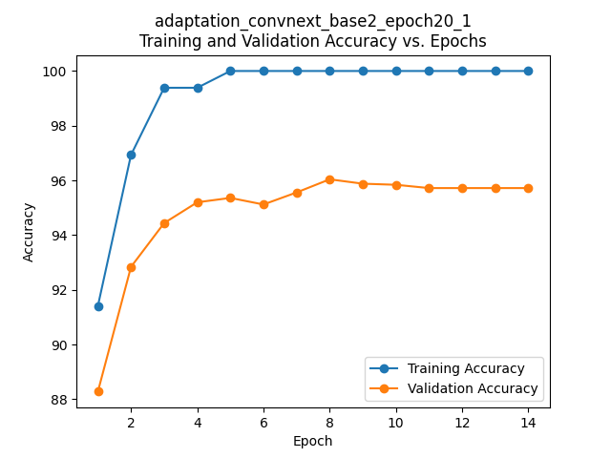
DEcryption
Finetune the adaptation network
ConvNeXt
Encrypted
Image
Adaptation
Network
Classification
result
Not trained well
Overfitted
Notes:
The learning ability of ConvNeXt is much stronger than the adaptation network. ConvNeXt always raises the training accuracy to nearly 100% percent in a short time, which means the adaptation network doesn’t have enough time to get well trained.

Slide 22
DEcryption
Supposition: Reserve the parameters of adaptation network while reloading ConvNeXt each time
Adaptation
Network
ConvNeXt
Training round 1:
Encrypted
Image
Classification
result
Weights
Adaptation
Network
ConvNeXt
Training round 2:
Encrypted
Image
Classification
result
Weights
…
Weights
Adaptation
Network
ConvNeXt
Training round n:
Encrypted
Image
Classification
result
Notes:
Each training round consists of several epochs.

Slide 23
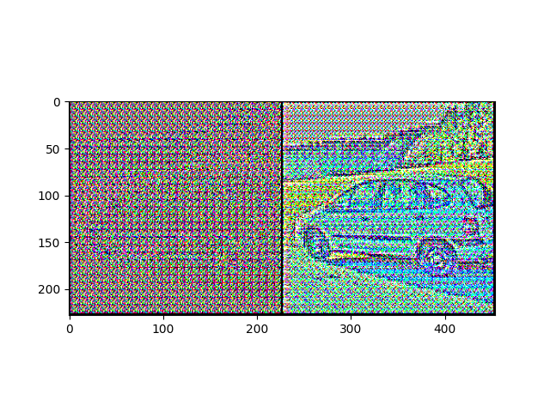
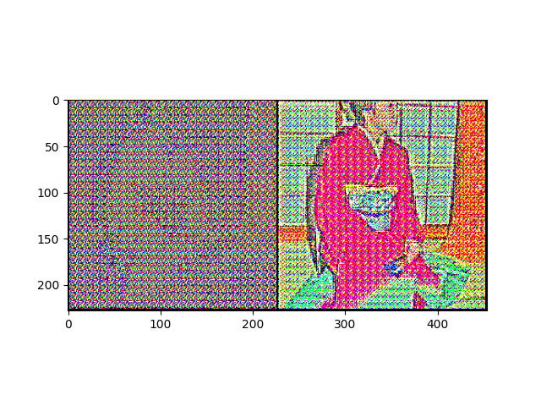
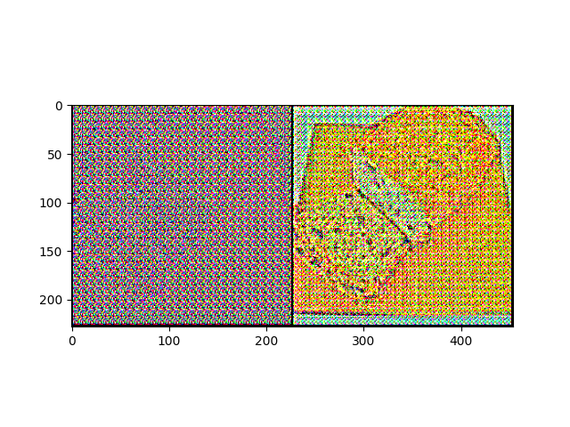
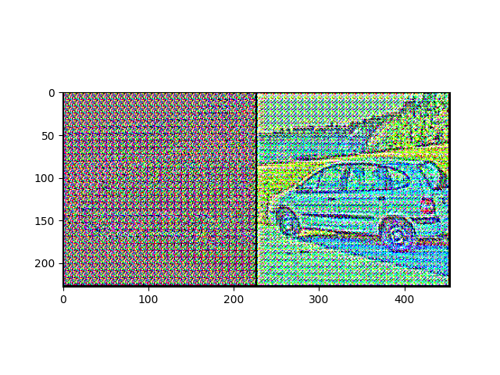
DEcryption
Evidence: The quality of the decrypted image significantly got better after another epoch of training
Notes:
The result is promising. We loaded the pre-trained parameters of the adaptation network, the result got significantly better after only one epoch. It reassured our supposition. We started to train our network in multiple rounds.

Slide 24
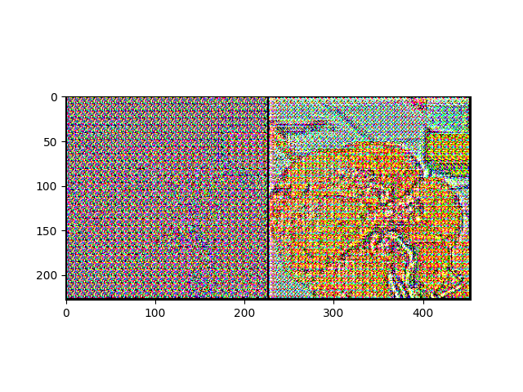
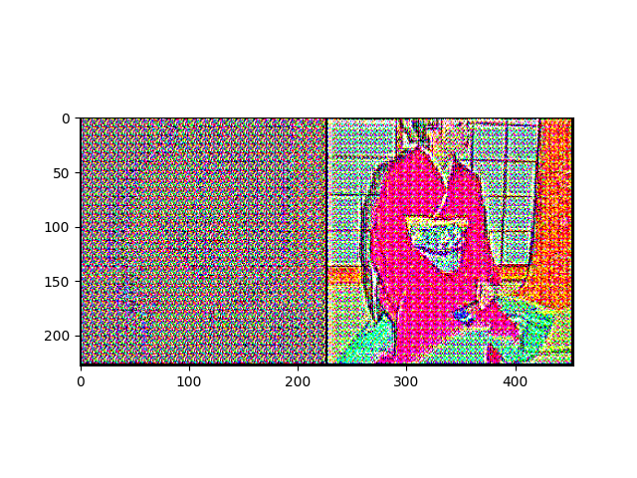
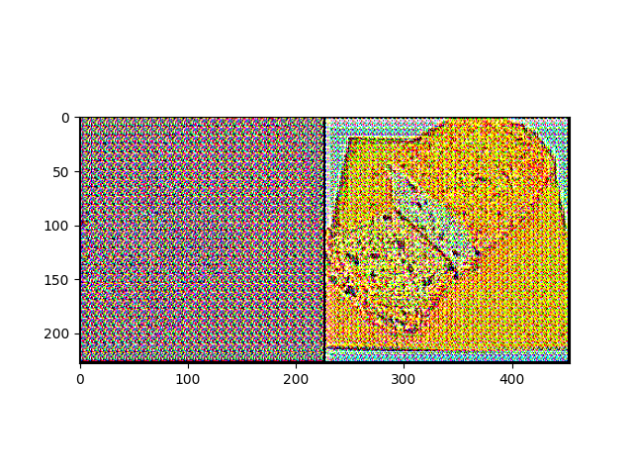
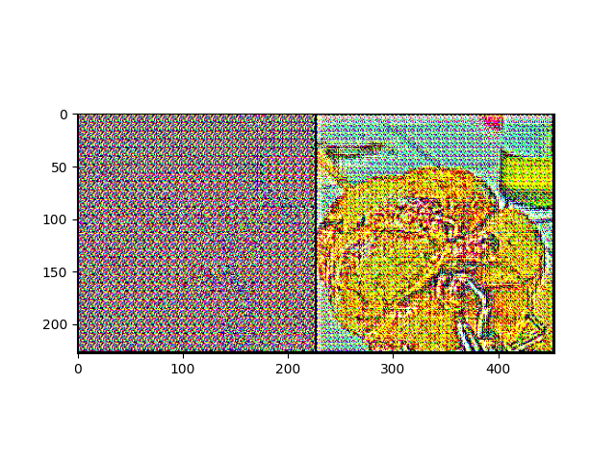
DEcryption
Final result of decryption on Dataset 2:
 | ConvNeXt_Base | ConvNeXt_Base + Adaption Net | ConvNeXt_Base + Adaption Net +Multi-round
Accuracy | 94.28% | 96.04% | 96.72%

Slide 25
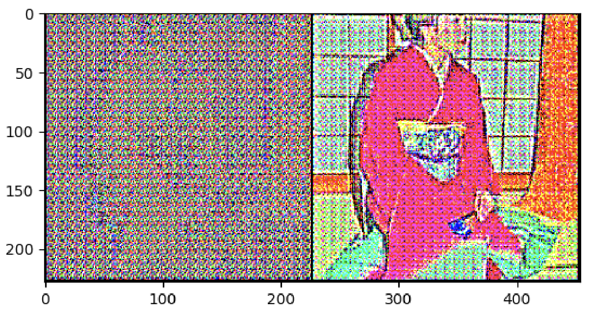
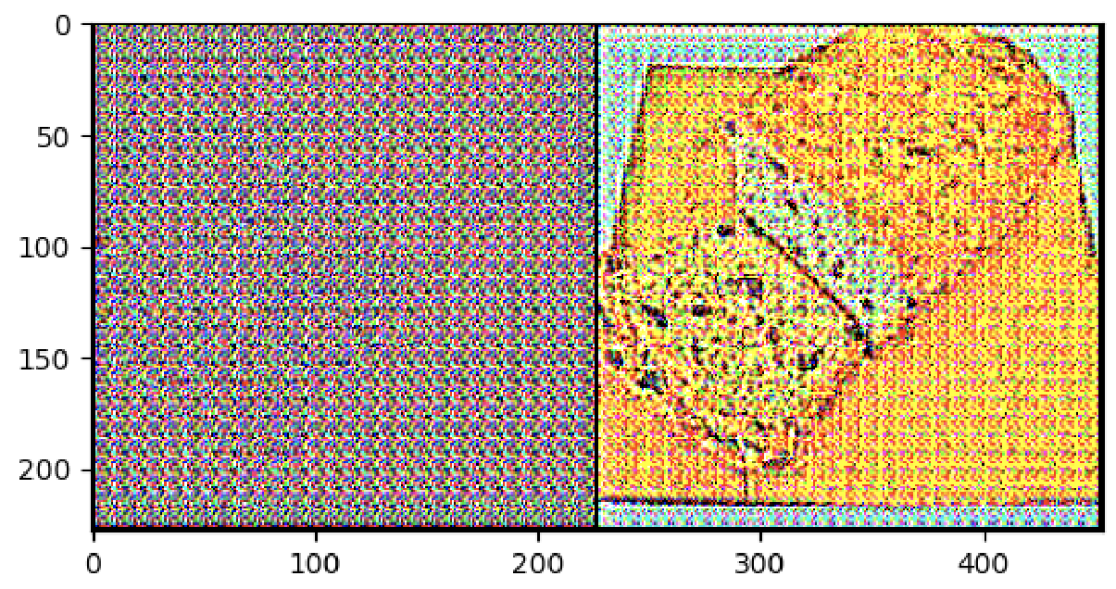
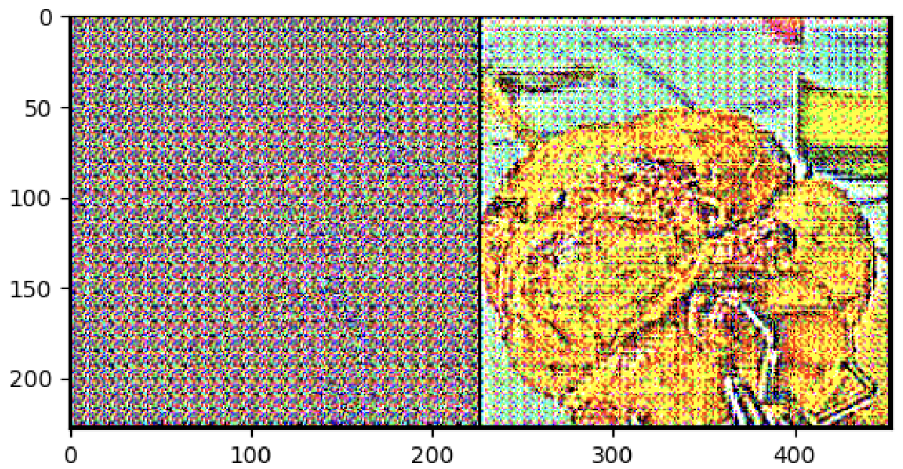
DEcryption
Final result of decryption on Dataset 2:
 | ConvNeXt_Base | ConvNeXt_Base + Adaption Net | ConvNeXt_Base + Adaption Net +Multi-round
Accuracy | 94.28% | 96.04% | 96.72%

Slide 26
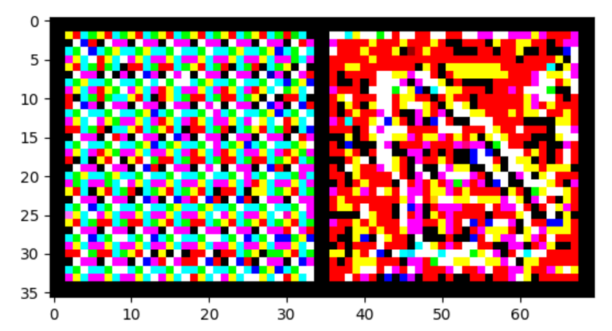
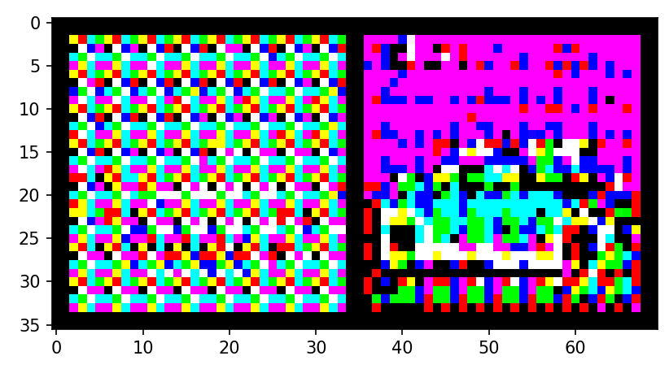
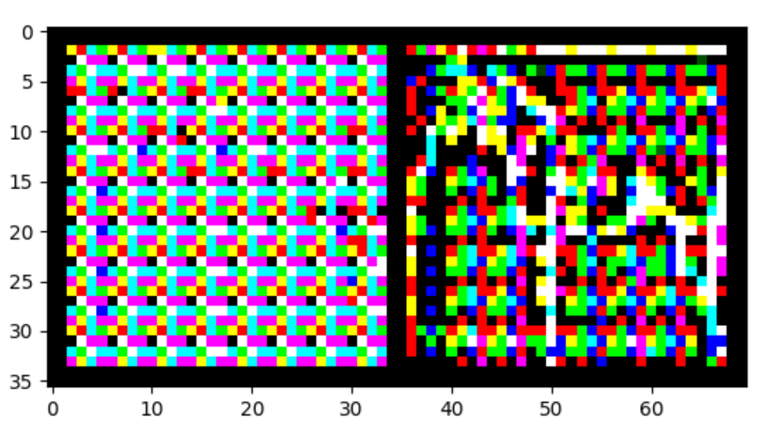
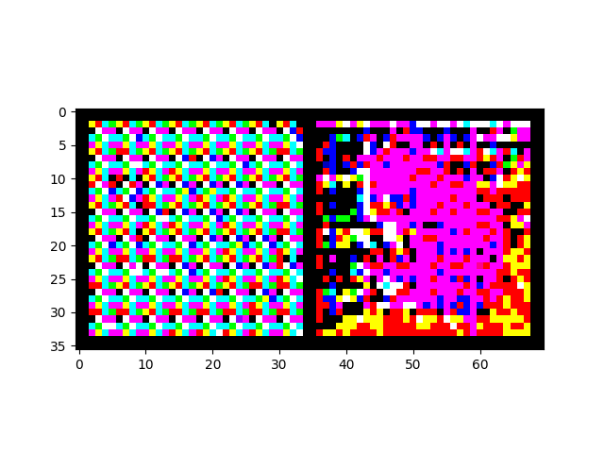
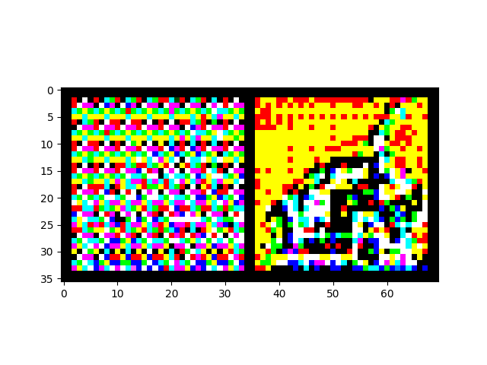
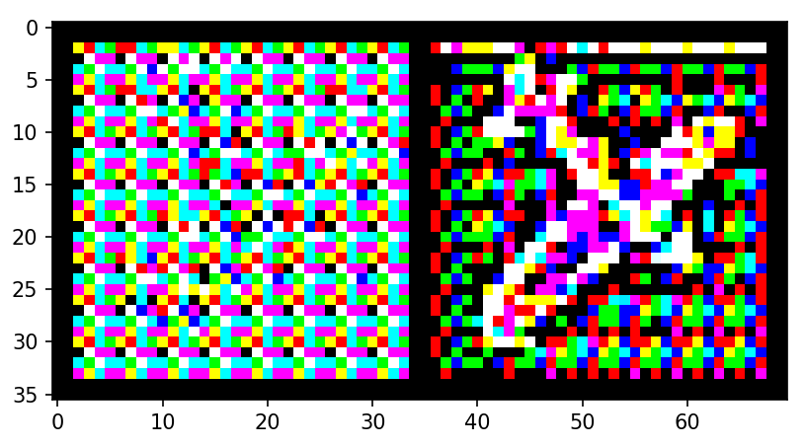
DEcryption
Final result of decryption on Dataset 1:
 | ConvNeXt_Base | ConvNeXt_Base + Adaption Net | ConvNeXt_Base + Adaption Net +Multi-round
Accuracy | 84.25% | 77.79% | 82.99%

Slide 27
Result summary
Our Team as a Service Provider:
Best Validation Accuracy on Dataset1: 84.25%
Best Validation Accuracy on Dataset2: 96.72%
Our Team as an eavesdropper :
Category Recognition on Dataset1: A Selected Few
Category Recognition on Dataset2: Almost 50

Slide 28
Thanks
Q&A

